Slide 1
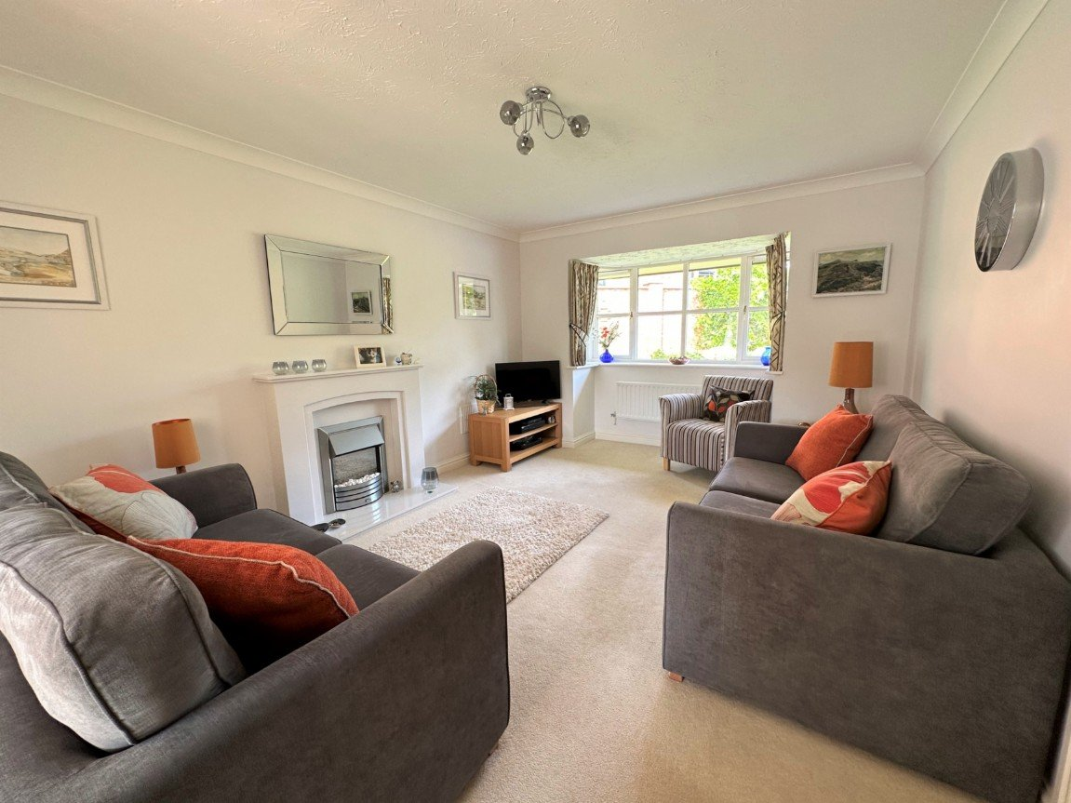
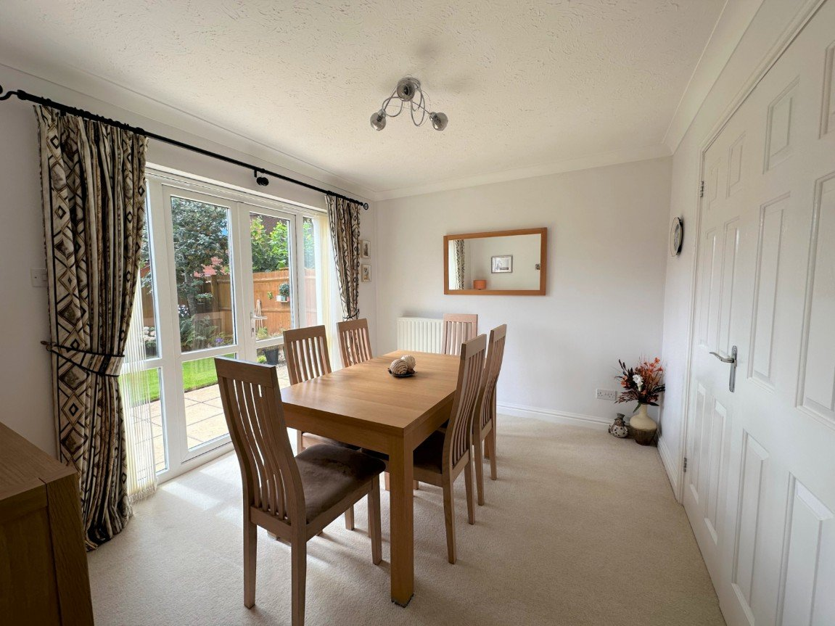
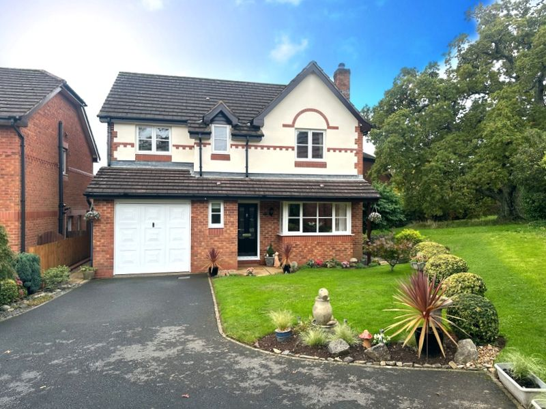
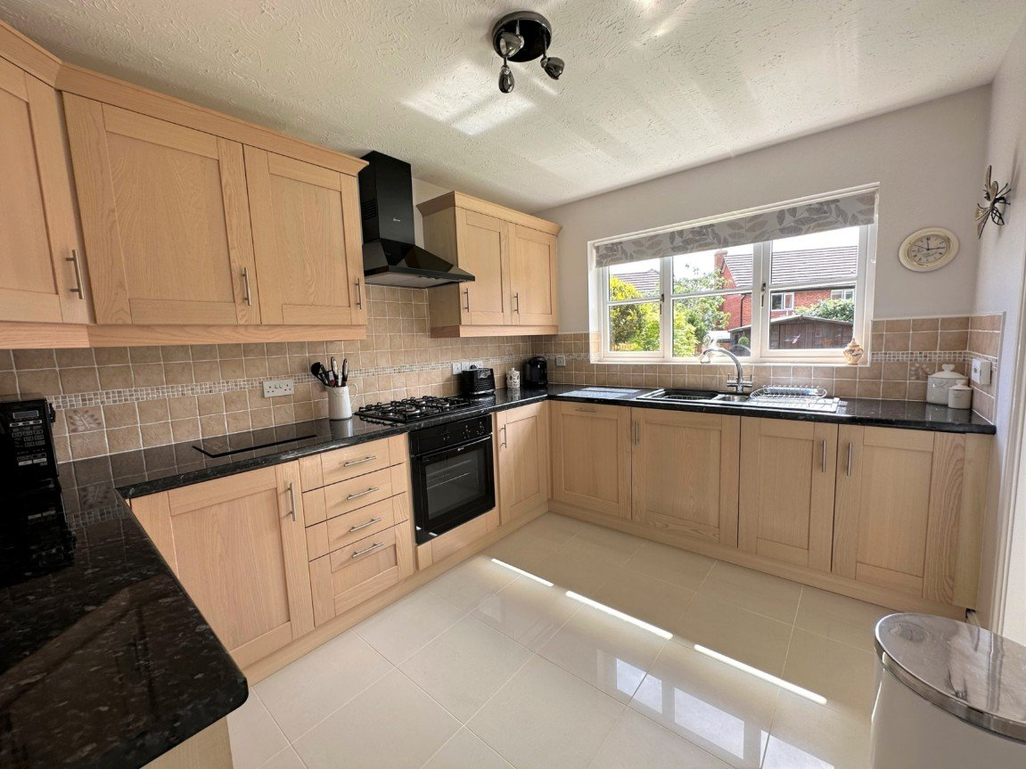
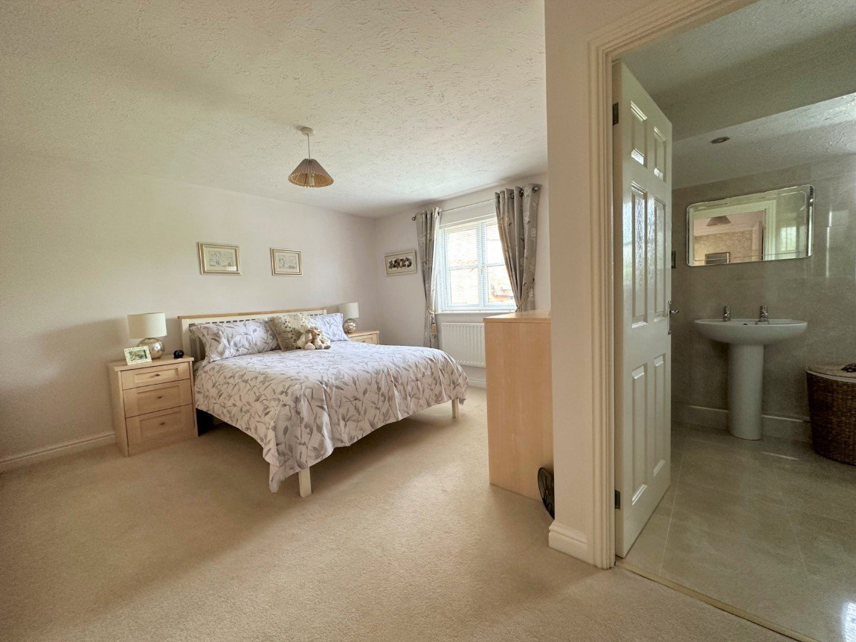
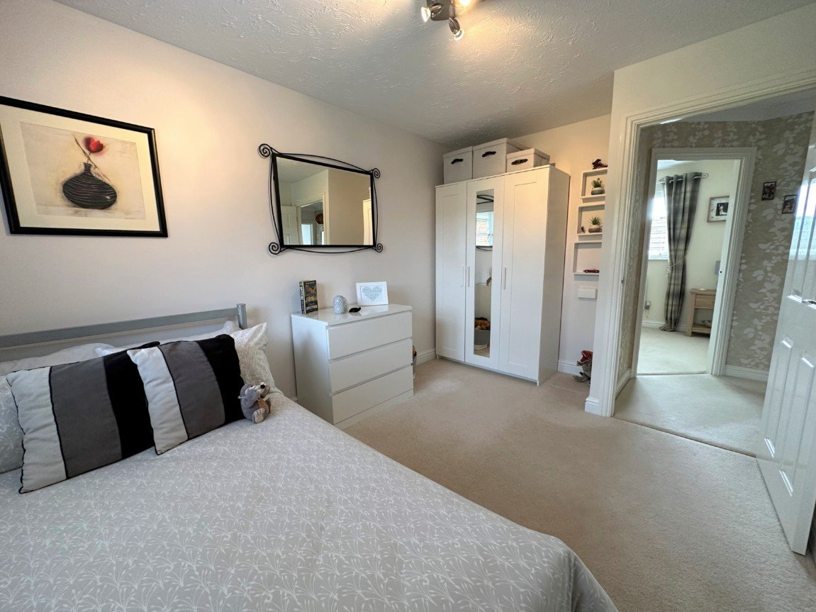
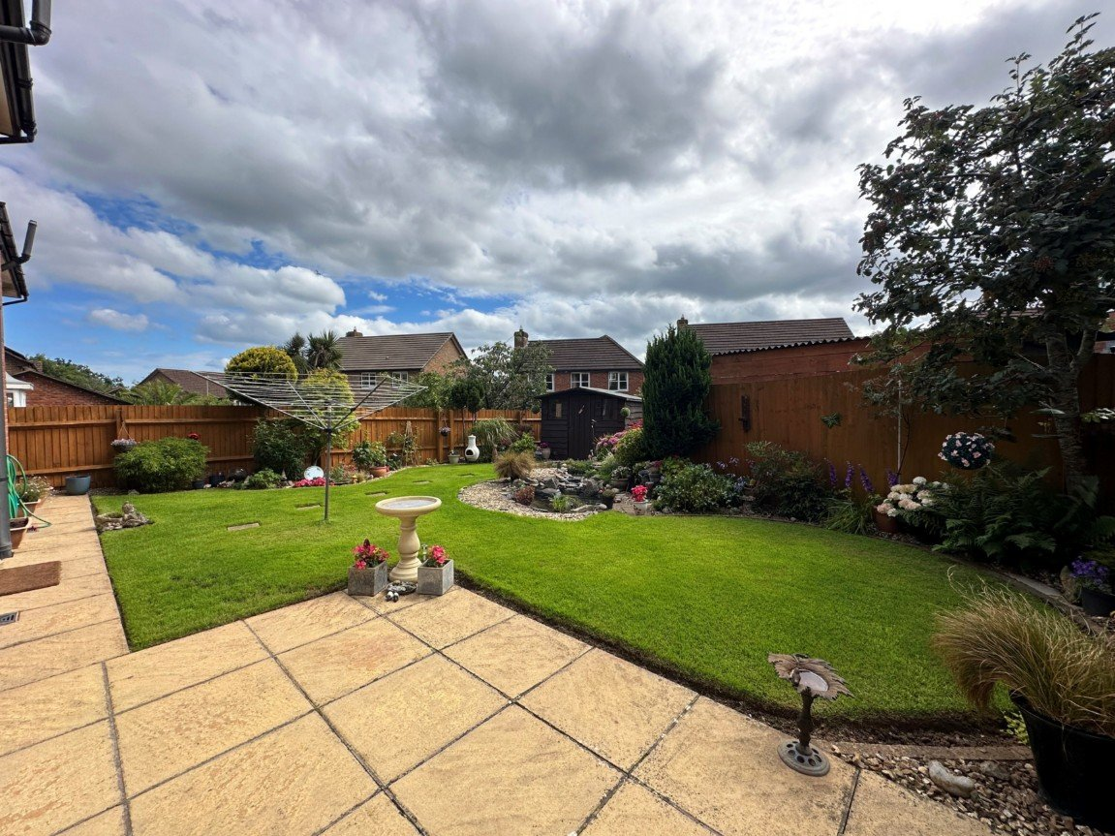
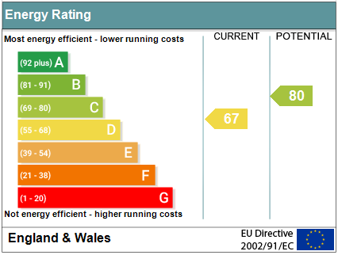
www.pennys.net
17 St. Sevan Way, Exmouth, Devon, EX8 5RE
GUIDE PRICE £499,950
TENURE Freehold
An Immaculately Presented Four Bedroom Detached Family House Located In A Highly Desirable Development With Ample Parking, Garage And Beautifully Landscaped Gardens
Reception Hall & Ground Floor Cloakroom/WC • Bay Windowed Lounge •
Separate Dining Room • Modern Kitchen • Utility Room •
Four First Floor Bedrooms - Main Bedroom With Ensuite Shower Room/WC •
Family Bathroom Suite • Gas Central Heating & uPVC Double Glazing •
Driveway Parking & Garage • Attractive Landscaped Gardens • Newly Decorated Exterior Render, Garage Door, Fascia's & Soffits •
Pennys Estate Agents Limited for themselves and for the vendor of this property whose agents they are give notice that:- (1) These particulars do not constitute any part of an offer or a contract. (2) All statements contained in these particulars are made without responsibility on the part of Pennys Estate Agents Limited. (3) None of the statements contained in these particulars are to be relied upon as a statement or representation of fact. (4) Any intending purchaser must satisfy himself/herself by inspection or otherwise as to the correctness of each of the statements contained in these particulars. (5) The vendor does not make or give and neither do Pennys Estate Agents Limited nor any person in their employment has any authority to make or give any representation or warranty whatever in relation to this property.
PENNYS ESTATE AGENTS
2 Rolle House, Rolle Street, Exmouth, Devon, EX8 2SN
Tel: 01395 264111 EMail: help@pennys.net

Slide 2
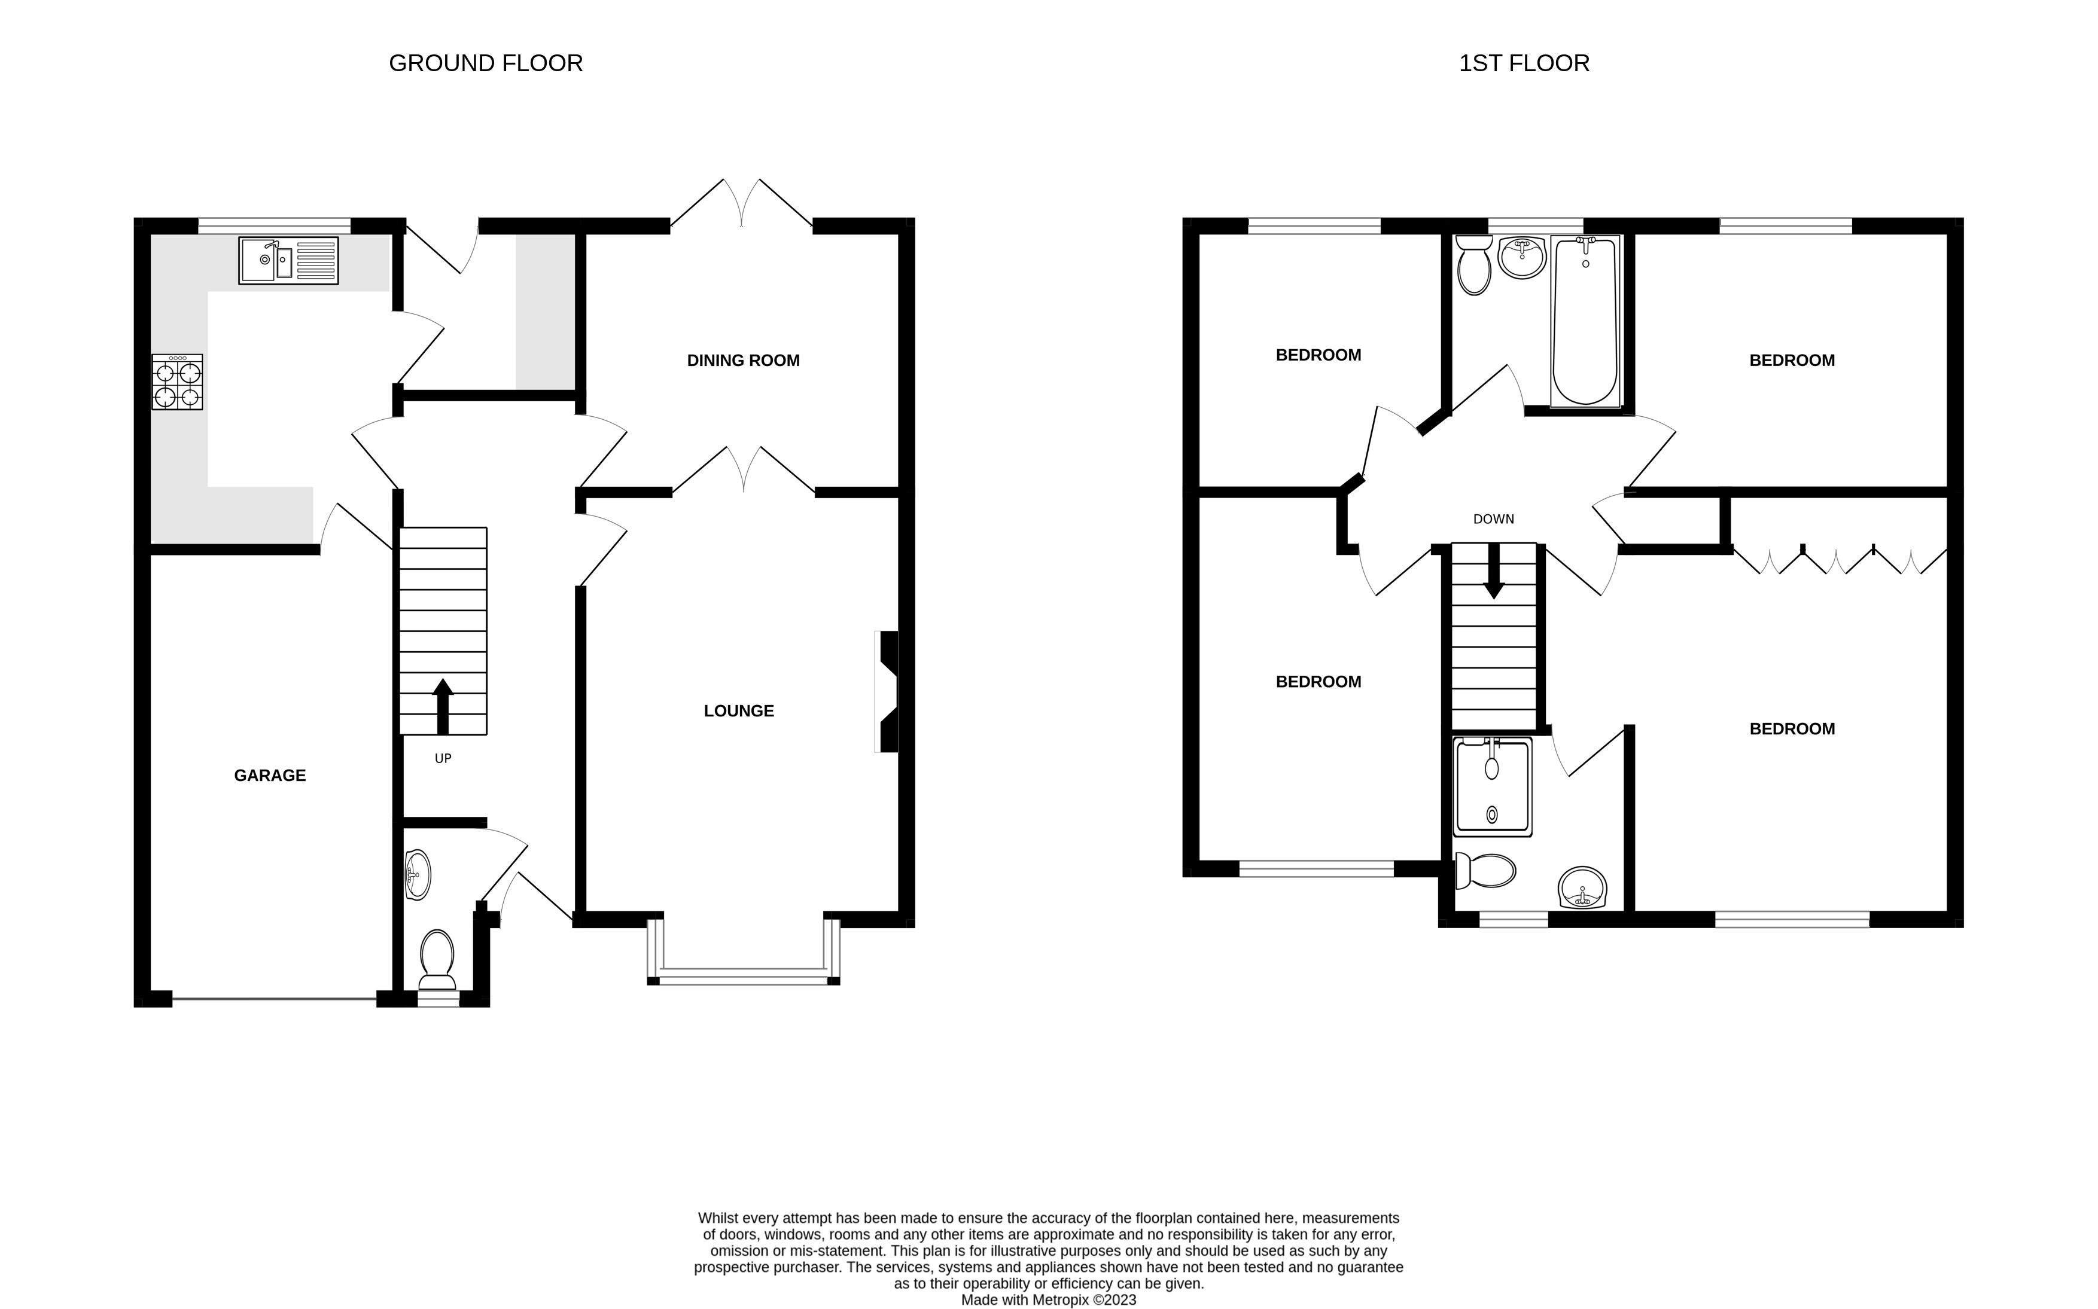
17 St. Sevan Way, Exmouth, Devon, EX8 5RE
THE ACCOMMODATION COMPRISES: ENTRANCE CANOPY: With courtesy light; front door with double glazed patterned window inset giving access to: RECEPTION HALL: A fine entrance to the property with staircase rising to the first floor landing with useful understairs storage cupboard beneath; porcelain tiled flooring; two radiators; smoke alarm; coved ceiling; doors to: GROUND FLOOR CLOAKROOM/WC: uPVC double glazed window with obscure glass to front aspect; WC; pedestal wash hand basin with tiled splash back; radiator. LOUNGE: 4.5m x 3.4m (14'9" x 11'2") Measurement into uPVC double glazed square bay window overlooking the front aspect. A most bright and spacious room with double doors leading to the DINING ROOM; electric flame effect fire standing in a granite hearth with matching mantle over; television point; radiator; full fibre telephone point; two radiators; carpet; coved ceiling. DINING ROOM: 3.4m x 2.82m (11'2" x 9'3") uPVC double glazed doors opening on to REAR GARDEN; coved ceiling; radiator; carpet. KITCHEN: 3.4m x 2.67m (11'2" x 8'9") Fitted with a range of gloss patterned work top surfaces with attractive tiled surrounds; range of base cupboards and drawer units; wall mounted cupboards; one and a half bowl sink drainer unit with chrome mixer tap; 'NEFF' built-in electric cooker; four ring gas hob with chimney style extractor hood over; integrated dishwasher; integrated fridge; porcelain tiled flooring; radiator; thermostat control for central heating; uPVC double glazed window to rear aspect; doors to: UTILITY ROOM: 1.91m x 1.75m (6'3" x 5'9") Fitted with a gloss patterned worktop surface with attractive tiled splashback; cupboard beneath; space and plumbing for automatic washing machine; space for tumble dryer; extractor fan; radiator; porcelain tiled floor; uPVC double glazed door with patterned inset giving access to rear garden. INTEGRAL GARAGE: 5m x 2.67m (16'5" x 8'9") Power and light connected; up and over door; electric consumer unit; wall mounted gas boiler serving domestic hot water and gas central heating; partial storage space in roof eaves.
FIRST FLOOR LANDING: With access to partially boarded roof space via loft ladder; smoke alarm; airing cupboard housing hot water tank with slatted shelving; doors to: BEDROOM ONE: 4.5m x 3.71m (14'9" x 12'2") Maximum overall measurement into door recess; uPVC double glazed window to front aspect; radiator; television point; a range of built-in wardrobes with hanging rails and shelving; carpet; door to: EN-SUITE SHOWER ROOM / WC: Comprising of corner shower cubicle with shower with attractive fully tiled walls; W.C with push button flush; pedestal wash hand basin with chrome taps and mirror above; chrome heated towel rail; porcelain tied floor; obscure glazed window to front aspect; ceiling spotlights; extractor fan; shaver socket.
BEDROOM TWO: 3.94m x 2.69m (12'11" x 8'10") Maximum measurement into recess; uPVC double glazed window to front aspect; radiator; carpet.
BEDROOM THREE: 3.43m x 3m (11'3" x 9'10") uPVC double glazed window to rear aspect; radiator; carpet. BEDROOM FOUR: 2.74m x 2.59m (9'0" x 8'6") uPVC double glazed window to rear aspect; radiator; carpet. BATHROOM: 2.06m x 1.8m (6'9" x 5'11") Comprising of bath with chrome mixer tap and hand shower attachment; pedestal wash hand basin with chrome taps; W.C with push button flush; obscure glazed window to rear aspect; chrome heated towel rail; fully tiled walls; porcelain tiled flooring; ceiling spotlights; extractor fan. OUTSIDE: The property is approached via a private driveway which gives access to parking for three vehicles. To the front of the property there is an attractive lawned area with a variety of well stocked flower beds and shrubs. There is a side pathway which gives access to the rear garden via a wooden gate. The REAR GARDEN is of a southerly aspect and is fully enclosed; comprising of a patio area ideal for al-fresco dining and outside entertainment; lawned area with borders of colourful well stocked plants and shrubs; a decorative stoned area with a feature pond; timber shed; outside tap; bin store area.
FLOOR PLAN:

